Slide 1

Do Video Games affect School Grades of Children?
Felipe Rodriguez

Slide 2
Overview
Interest
Research
Challenges
Conclusion

Slide 3

Interest
76% of children in the US play video games
Affects are debated to this day
What is the correlation between playing video games and school grades?

Slide 4
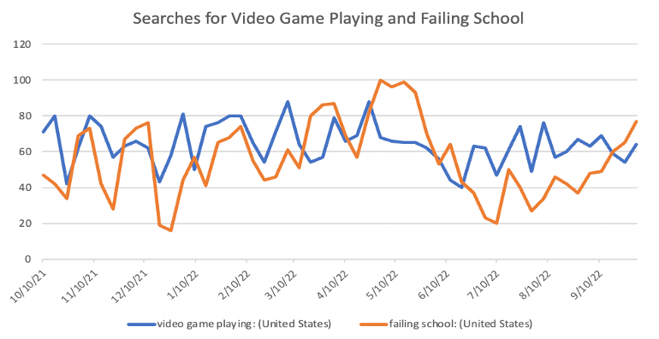
Research
"Video game playing" and "failing school" searches in the US trend very similarly
Studies show that kids playing video games spend less time playing video games
Vivek Anand (2007) finds that there is a correlation between amount of time spent playing video games and GPA and SAT scores

Slide 5

Challenges
Limited testing
Outside Factors not considered
Bias when testing
Time to test

Slide 6
Conclusion
Assumption can be made that videos games affect children's grades
More extensive testing need
Outside factors and bias need to be addressed

Slide 7
Reference
Reference:
Anand, V. (2007, August 21). A study of time management: The correlation between video game usage ... A Study of Time Management: The Correlation between Video Game Usage and Academic Performance Markers. Retrieved October 9, 2022, from https://www.liebertpub.com/doi/abs/10.1089/cpb.2007.9991
Chivers, K. (2021, January 14). 2020 video game ratings in review, and what they mean to gamers. Norton. Retrieved September 15, 2022, from https://us.norton.com/internetsecurity-kids-safety-video-game-ratings.html
Dewar, G. (2022, March 13). The effects of video games on School Achievement. PARENTING SCIENCE. Retrieved October 9, 2022, from https://parentingscience.com/effects-of-video-games-on-school/
Entertainment Software Association. (2022, February 7). 2021 Essential Facts About the Video Game Industry. Retrieved September 15, 2022, from https://www.theesa.com/resource/2021-essential-facts-about-the-video-game-industry/).
Merriam-Webster. (2022, September 4). Video game definition & meaning. Merriam-Webster. Retrieved September 15, 2022, from https://www.merriam-webster.com/dictionary/video%20game
Our history. ESRB Ratings. (2021, December 9). Retrieved October 9, 2022, from https://www.esrb.org/history
The good and the bad effects of video games on children. Institute for Educational Advancement. (2022, May 21). Retrieved September 15, 2022, from https://educationaladvancement.org/blog-the-good-and-the-bad-effects-of-video-games-on-children/
Violent video game definition. Law Insider. (n.d.). Retrieved September 15, 2022, from https://www.lawinsider.com/dictionary/violent-video-game
Wright, Jancee (2011) "The effects of video game play on academic performance," Modern Psychological Studies: Vol. 17: No. 1, Article 6. Available at: https://scholar.utc.edu/mps/vol17/iss1/6

